Slide 1
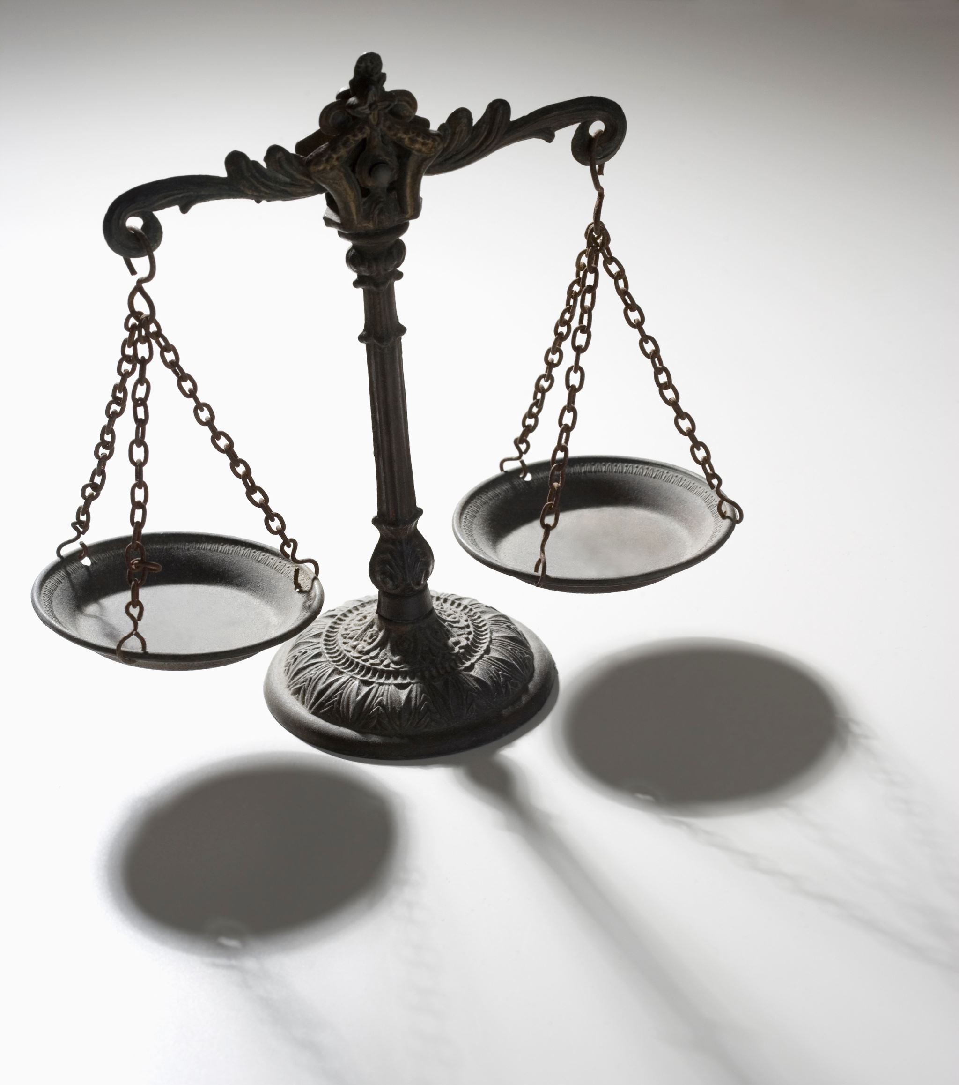
Legal Aspects

Slide 2
DOMAIN 1: LEGAL & REGULATORY
legal and regulatory issues that pertain to information security in a global context
➢ Cyber crimes and data breaches
➢ Trans-border data flow
➢ Licensing and intellectual property
requirements
➢ Privacy
➢ Import/export controls

Slide 3
DOMAIN 1: LEGAL & REGULATORY
Types of Law
Criminal Law. contains prohibitions against acts
such as murder, assault, robbery, and arson.
Civil Law. include contract disputes, real estate
transactions, employment, estate, and probate.
Administrative Law. Government agencies have
some leeway to enact administrative law.
CISSP exam focuses on security-related generalities
of law, regulations, investigations, and compliance

Slide 4
DUE DILIGENCE VS DUE CARE
Due
Diligence
practicing the activities that maintain the due care effort.
Due
Care
doing what a reasonable person would do in a given situation. It is sometimes called the “prudent man” rule.
Together, these will reduce senior management’s culpability & (downstream) liability when a loss occurs.

Slide 5
DUE DILIGENCE
Decision
Research
Planning
Evaluation
Implementation
Operation (upkeep)
Reasonable measures
INCREASES understanding and REDUCES risk
“PRUDENT MAN” RULE
Largely before the decision
Doing after the decision
DUE CARE

Slide 6
DUE DILIGENCE
BEFORE
Decision
AFTER
Think BEFORE
you act!
Actions speak
louder than words
Do Detect
Do Correct
DUE CARE

Slide 7
DUE DILIGENCE
BEFORE
Decision
AFTER
EXAMPLES
EXAMPLES
Knowledge and research of:
Delivery or execution including:
✓ Laws and Regulations
✓ Industry standards
✓ Best practices
✓ Reporting security incidents
✓ Security awareness training
✓ Disabling access in a timely way
DUE CARE

Slide 8
Privacy vs Confidentiality
ISSUES RELATED TO PRIVACY
What is the difference?
Privacy
Confidentiality
The right of an individual to have some control over how their personal information (PII, PHI) is collected, used, and potentially disclosed.
The duty to ensure private information is kept secret to the extent possible.
A legal obligation in regulatory scenarios, and a due care obligation in U.S. law
Focus on rights of the
individual person/customer
Focuses on data

Slide 9
LEGAL & REGULATORY
Laws
Computer Fraud and Abuse Act (CFAA). The first major
piece of US cybercrime-specific legislation
Federal Sentencing Guidelines. provided punishment
guidelines to help federal judges interpret computer crime
laws.
Federal Information Security Management Act (FISMA).
Required a formal infosec operations for federal gov’t
Copyright and the Digital Millennium Copyright Act. Covers
literary, musical, and dramatic works.

Slide 10
DOMAIN 1: LEGAL & REGULATORY
Other US privacy laws
HIPAA (Health Insurance Portability and Accountability Act)
HITECH (Health Information Technology for Economic and
Clinical Health)
Gramm-Leach-Bliley Act (financial institutions)
✓
Children’s Online Privacy Protection Act (COPPA)
✓
Electronic Communications Privacy Act (ECPA)
Communications Assistance for Law Enforcement Act
(CALEA)
✓

Slide 11
Other privacy laws
ISSUES RELATED TO PRIVACY
Personal Information Protection Law (PIPL)
Effective since late 2021, PIPL aims to establish a comprehensive framework for the protection of personal information in China.
Protection of Personal Information Act (POPIA)
Enacted in 2013, establishes regulations for the responsible processing of personal information by both public and private entities in South Africa.
Both address data collection, security, usage, and deletion

Slide 12
Privacy laws covered on the CISSP exam:
ISSUES RELATED TO PRIVACY
US (Federal)
International
✓ GLBA (financial)
✓ HIPAA/HITECH (health)
✓ COPPA (children)
✓ ECPA (electronic)
✓ CALEA (wiretapping)
✓ GDPR (EU)
✓ PIPL (China)
✓ POPIA (South Africa)
GDPR is the most important
US (State)
For US, focus on Federal
CCPA (California)

Slide 13
PRIVACY IMPACT ASSESSMENT
What is a PIA?
a Privacy Impact Assessment (PIA) is designed to identify the privacy data being collected, processed, or stored by a system, and assess the effects of a data breach
When is a PIA necessary?
Several privacy laws explicitly require PIAs as a planning tool for identifying and implementing required privacy controls, including GDPR and HIPAA.
Conducting a PIA typically begins when a system or process is being evaluated
However, evolving privacy regulation often necessitates assessment of existing systems.
To conduct a PIA, you must define assessment scope, data collection methods, and plan for data retention
The International Association of Privacy Professionals (IAPP) has published guides and resources related to privacy efforts, including PIA.

Slide 14
LEGAL & REGULATORY
Encryption and Privacy
Computer Export Controls. US companies can’t export to
Cuba, Iran, North Korea, Sudan, and Syria.
Encryption Export Controls. Dept of Commerce details
limitations on export of encryption products outside the US..
Privacy (US). The basis for privacy rights is in the Fourth Amendment to the U.S. Constitution.
Privacy (EU). General Data Protection Regulation (GDPR) is
not a US law, but very likely to be mentioned!
Applies to any company with customers in the EU!

Slide 15
General Data Protection Regulation (GDPR)
General Data Protection Regulation (GDPR) is a legal framework that sets guidelines for the collection and processing of personal information from individuals who live in the European Union (EU).
Since the Regulation applies regardless of where websites are based, it must be heeded by all sites that attract European visitors, even if they don't specifically market goods or services to EU residents
GDPR mandates that EU visitors be given a number of data disclosures.

Slide 16
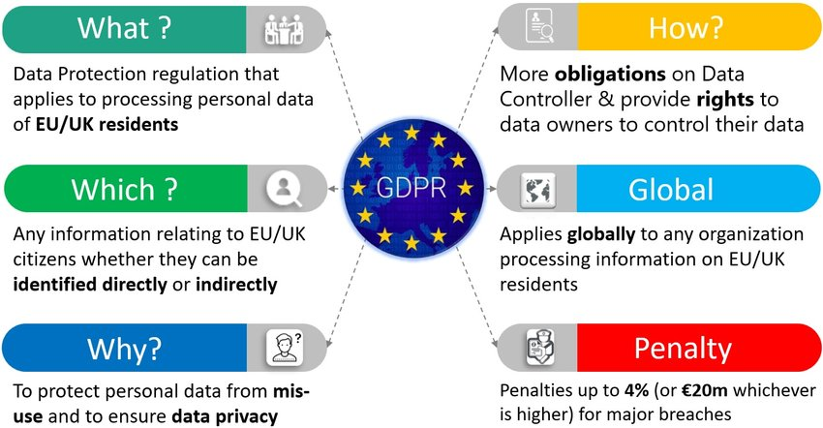

Slide 17
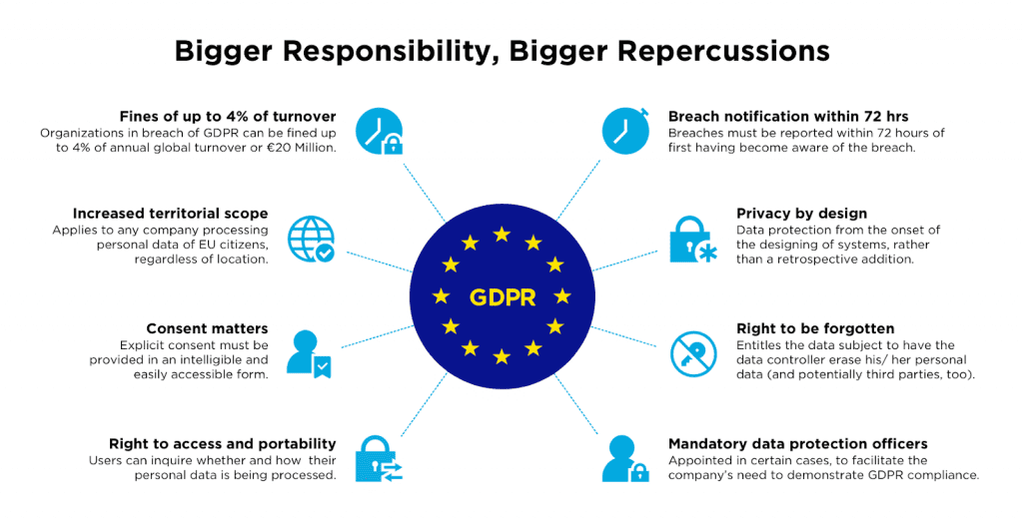

Slide 18
DOMAIN 1: LEGAL & REGULATORY
Intellectual Property and Licensing
Trademarks. covers words, slogans, and logos used
to identify a company and its products or services.
Patents. Patents protect the intellectual property
rights of inventors.
Trade Secrets. intellectual property that is absolutely
critical to their business and must not be disclosed.
Licensing. 4 types you should know are contractual,
shrink-wrap, click-through, and cloud services.

Slide 19
Intellectual Property Protections
Copyrights protect art, music, literature, or source code created by an individual or an organization.
Copyright infringement occurs when an individual uses art, music, literature, or source code that was created by a third party without that third party’s permission or without a specific license to use that individual's creation.
A copyright on a work is typically designated by a copyright statement that includes the year that the work was created or copyrighted.

Slide 20
ISC² CODE OF ETHICS
Memorize the ISC² code of ethics
1
Protect society, the commonwealth,
and the infrastructure
2
Act honorably, honestly, justly,
responsibly, and legally
3
Provide diligent and competent
service to principals
4
Advance and protect the profession

Slide 21

ISC2 Code of Ethics Canons
The canons are applied in order, and when faced with an ethical dilemma, you must follow the canons in order.
In other words, it is more important to protect society than to advance and protect the profession.

Slide 22
DOMAIN 1: USER EDUCATION
Establish and maintain a security awareness, education, and training program
➢ Methods and techniques to present
awareness and training
➢ Periodic content reviews
➢ Program effectiveness evaluation

